Slide 1
CSE712 Midterm Presentation
Presented by
Group 4
21166033 Rafeed Rahman
21366016 Riyo Hayat Khan
21366021 Dibyo Fabian Dofadar
21366035 Md. Sabbir Ahmed
2352574989 Sajib Kumar Saha Joy
Emotion Recognition under Consideration of the Emotion Component Process Model

Slide 2
Introduction
Emotion classification in text
Emotion Component Process Model (CPM) by Scherer (2005)
Emotion communication in text follow the five subsystems of CPM
Study of how emotions are communicated following the component model in Tweets and in Literature
Research goals
To understand if emotion components are distributed similarly across emotion categories and domains
To evaluate if informing an emotion classifier about emotion components improves their performance (and to evaluate various classification approaches).

Slide 3
Emotion Models
Ekman considered anger, disgust, fear, joy, sadness and surprise as basic emotions
Nine characteristics of a basic emotion
Plutchik proposed a model with eight main emotions
Complementary approach to categorizing emotions in discrete sets
The five components of Appraisals model proposed by Scherer
Infer the emotion experienced by a person by analyzing the set of changes in the five components

Slide 4
Emotion Analysis in Text
The majority of modelling approaches focuses on the analysis of fundamental emotions
Work with a focus on other aspects of emotions is rare
The work of Scherer and Wallbott focus on the existence in the described event
Holfmann and his team’s done a prediction of emotion categories based on the component of the CPM
Kim and Klinger analyze the emotions in fan fictions

Slide 5
Corpus Annotation
Corpus Selection
REMAN Corpus
Twitter Emotion Corpus (TEC)
Annotation Procedure & Inter-Annotator Agreement
Procedure
Guideline Refinement Process
Corpus Statistics
Dominant Emotions
Component Distribution

Slide 6
Methods
Emotion Classifier:
Are not particularly informed about emotion components
Emo-ME-Base
As preprocessing, they convert all words to lowercase, and stem them with the PorterStemmer.
TF-IDF-weighted bag-of-words unigram and bigram features.
On TEC, with its single-label annotation, Emo-ME-Base consists of one model, while on REMAN with multi-label annotation, they use 10 binary classifiers.
Emo-NN-Base
Emo-NN-Base uses pre-trained BERT sentence embeddings as input features. The network architecture
consists of a bidirectional LSTM layer followed by a convolutional layer.
The outputs of the convolutional layer are max-pooled over the dimension of the input sequence,
On top of the pooling layer is a fully connected layer. Its outputs are finally fed into an output layer with a sigmoid activation function for making the prediction
Dropout is used after each layer to tackle overfitting.
Emo-Cpm-NN-Pred
Predict emotion by combining Emo-NN-Base model and Cpm-NN-Base model through fully connected layer.

Slide 7
Methods
Component Classifier:
The emotion component classifiers predict which of the five CPM components occur in a text instance.
Cpm-ME-Base
Cpm-ME-Base baseline models (one for each component) only use bag-of-words features in the same configuration as Emo-ME-Base.
Cpm-NN-Base
The Cpm-NN-Base is configured analogously to Emo-NN-Base.
Cpm-ME-Adv
Add task specific features, namely features derived from manually crafted small dictionaries with words associated with the different components.

Slide 8
Methods
Joint Modelling and Multi-Task Learning
of Emotions and Components:
Predicts emotion and its component at the same time
To analyze if emotion classification benefits from the component prediction.

Slide 9
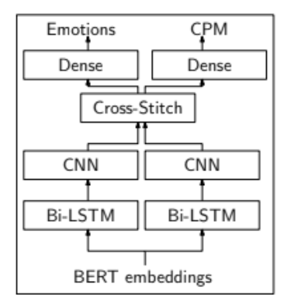
Figure: Joint multi tasking model for predicting emotion and its component at the same (MTL-XS)

Slide 10
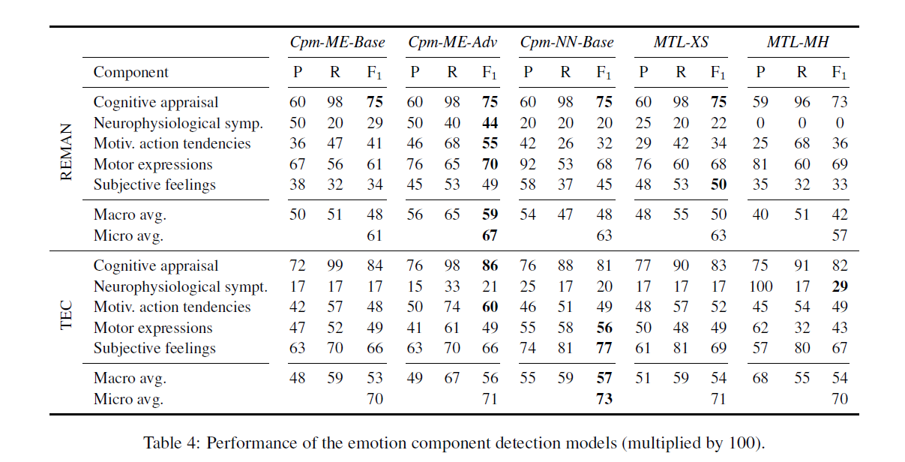
Component Prediction
Results

Slide 11
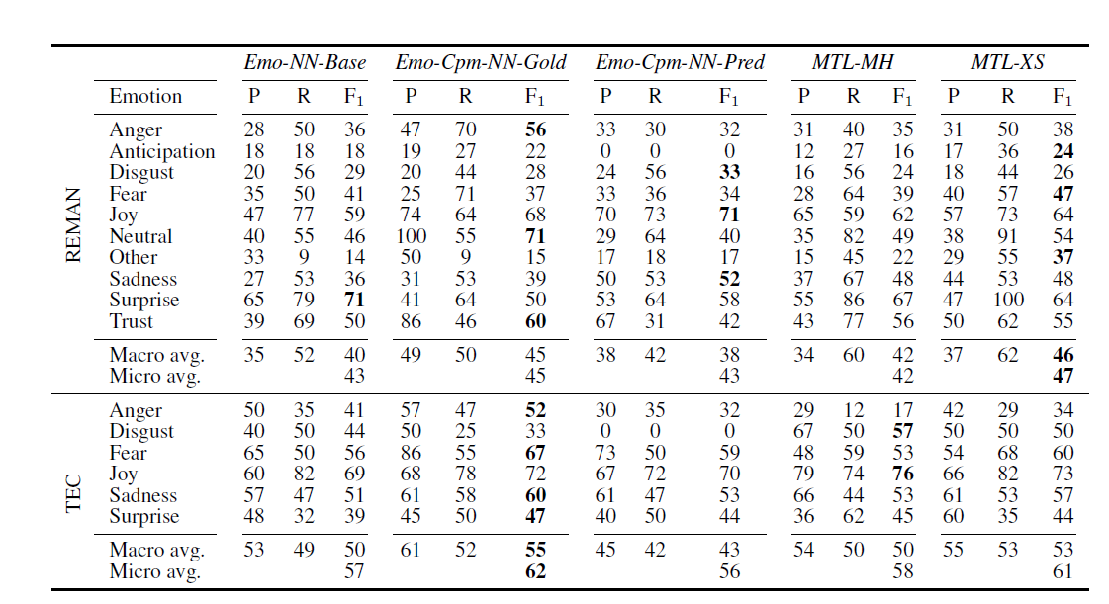
Emotion Classification

Slide 12
Conclusion
The authors presented the first data sets (based on existing emotion corpora) with emotion component annotation
With this paper they moved to another psychological theory, namely the emotion component process model, and made the first annotations available that closely follow this theory.
They have shown that, even with a comparably limited data set size, emotion components contribute to emotion classification. They expect that with a larger corpus the improvement would be more substantial than it is already now.

